Slide 1
FERTILITY, GESTATION, GROWTH

Slide 2
WHAT
HOW
HOW MUCH
Notes:
John and Terry did pick a diet balanced for gestation for their bitches… However we can tell you one thing here : they haven’t used it properly here.
The Chihuahua was properly overfed, which has we talked about can have consequences…
The Setter is certainly expecting a very large litter… and because of the uterus compressing the stomach, that might explain why she is never able to finish her meals…
Selecting the right diet is an important step. But using it properly is almost as important. And here there are few things they should have known when it comes to feeding bitches during gestation.

Slide 3
SUPPLEMENTS, NOT ALWAYS A GOOD THING…
HOWEVER…

Slide 4
Picture of a pregnant woman
With text : Folic Acid
On click Replace background by picture of a pregnant bitch
On click : make appear graph on following slide on top of it (in footer when this one appears, add reference Colqhoun et al, 1997)
FOLIC ACID

Slide 5
FOLIC ACID
FOLIC ACID SUPPLEMENTATION
PRO-ŒSTRUS
ŒSTRUS
GESTATION
17.6%
-76%
4.2%
CONTROL
CONTROL
+ FOLIC ACID
Colqhoun et al, 1997

Slide 6
FOLIC ACID
Supplementation 101
Bring back picture of the pregnant bitch in background
Text as title : Folic Acid Supplementation 101
Arrows appearing one after the other around the picture with the following text :
First 40 days !
Compliance !
Nutrition-related only !
First 40 days !
Nutrition-related only !
Compliance !

Slide 7
EPA-DHA

Slide 8
70%
Weight gain during last 20d of gestation
(Fontaine, 2012)
42-63 days of gestation = +10% energy/week
0-42 days of gestation = maintenance

Slide 9
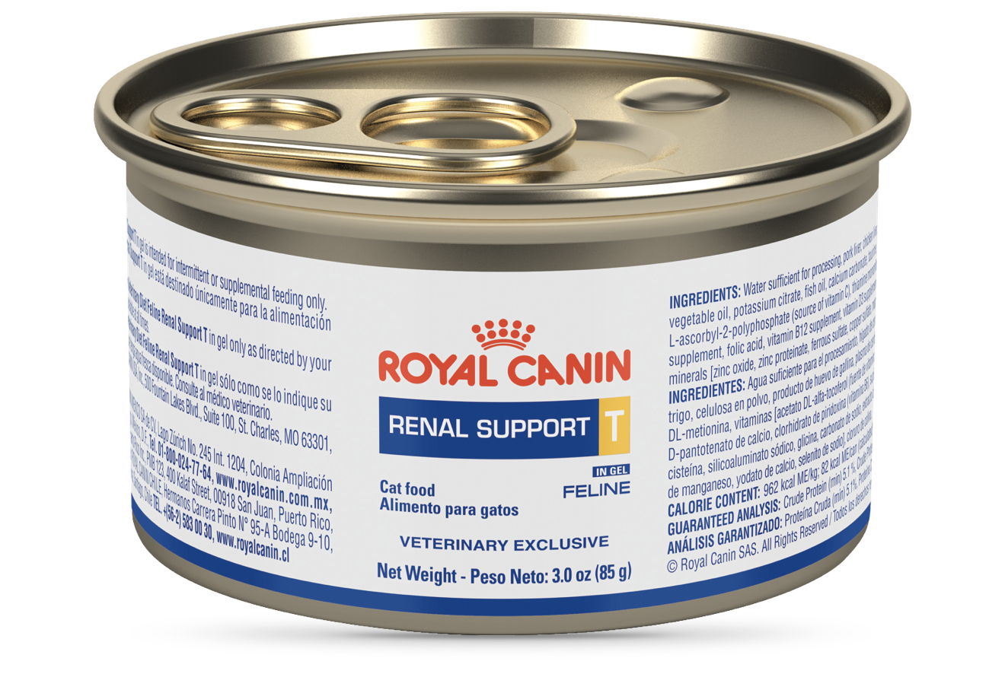
PRACTICAL TIP

Slide 10
WHAT
HOW
HOW MUCH

Slide 11
At the time of whelping, a bitch body weight should increase by approximately
15-25%

Slide 12
?
Question mark and next to it following text : Back to back breeding
On click : make appear below following text : Optimal BCS needed !
BACK TO BACK BREEDING
OPTIMAL BCS NEEDED !

Slide 13
LACTATION
= FREE FEEDING

Slide 14
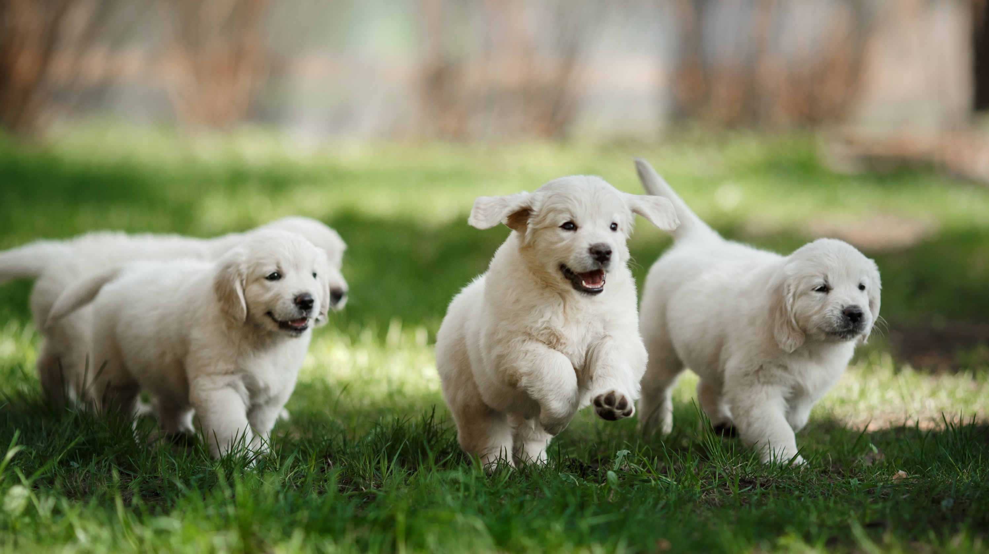
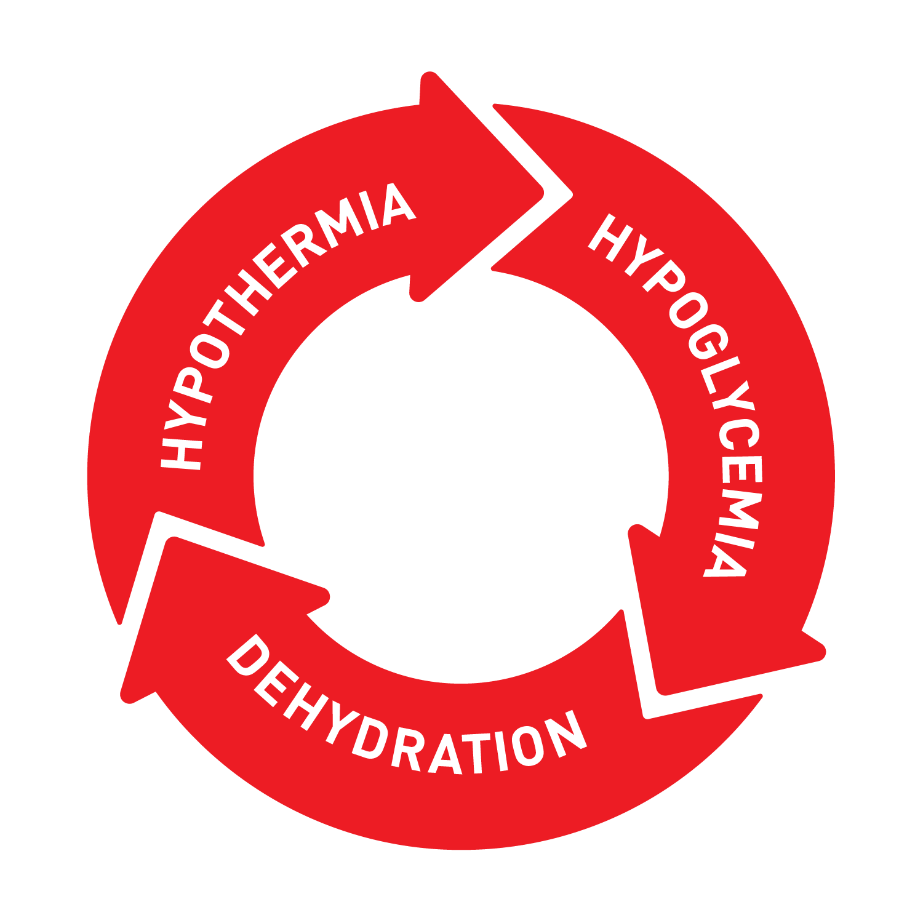

Slide 15
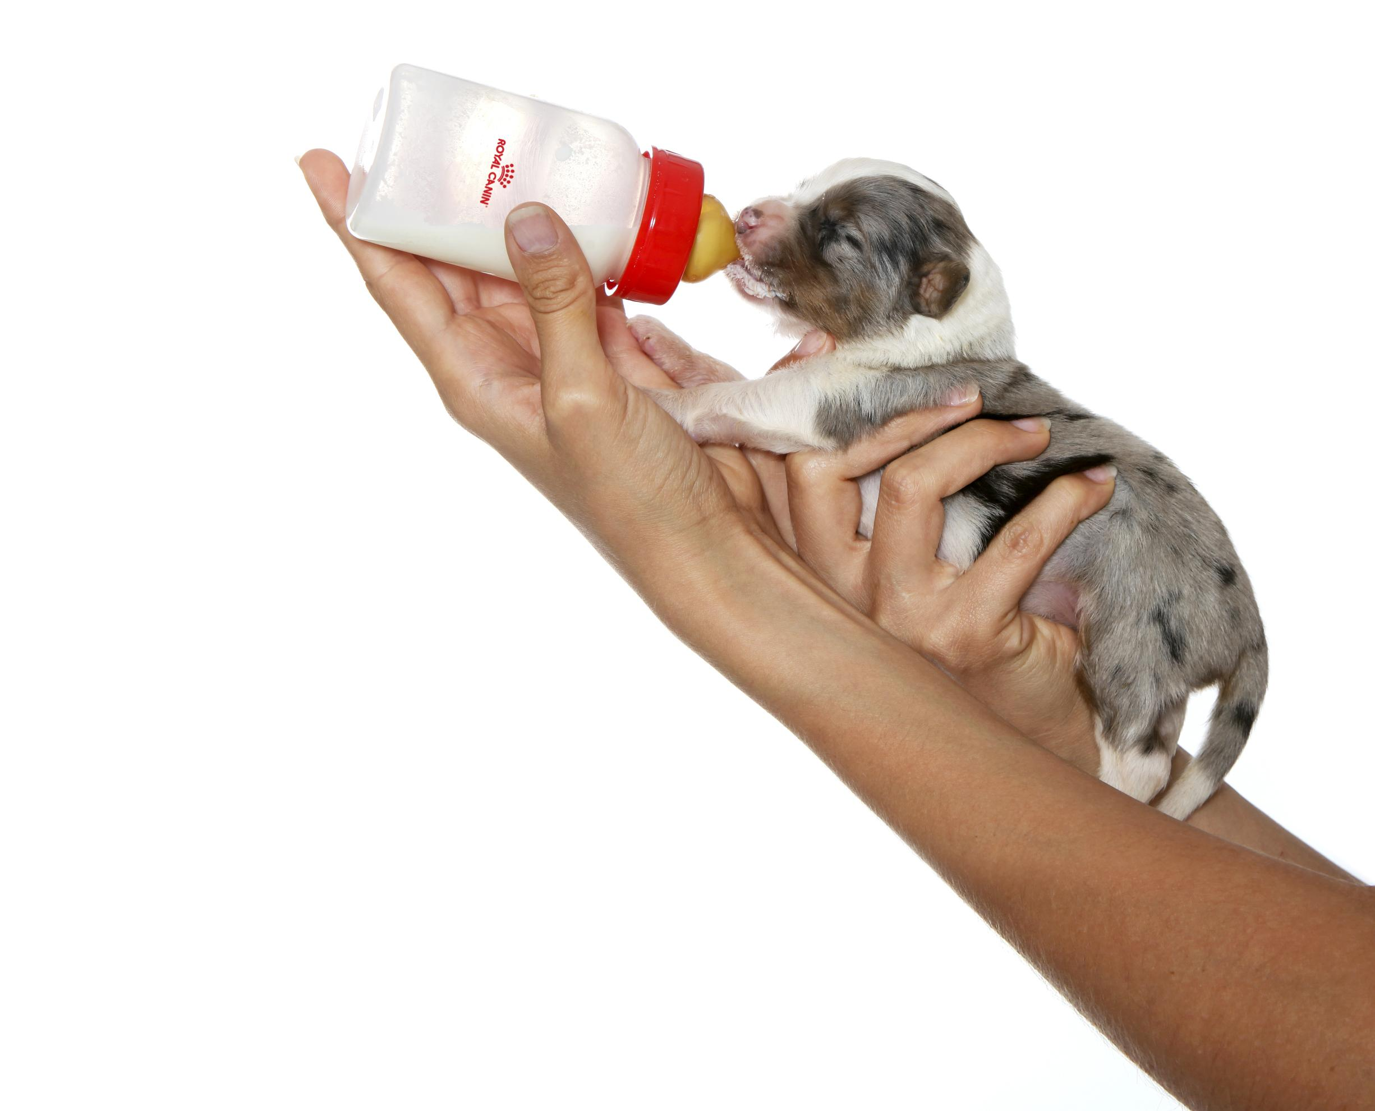
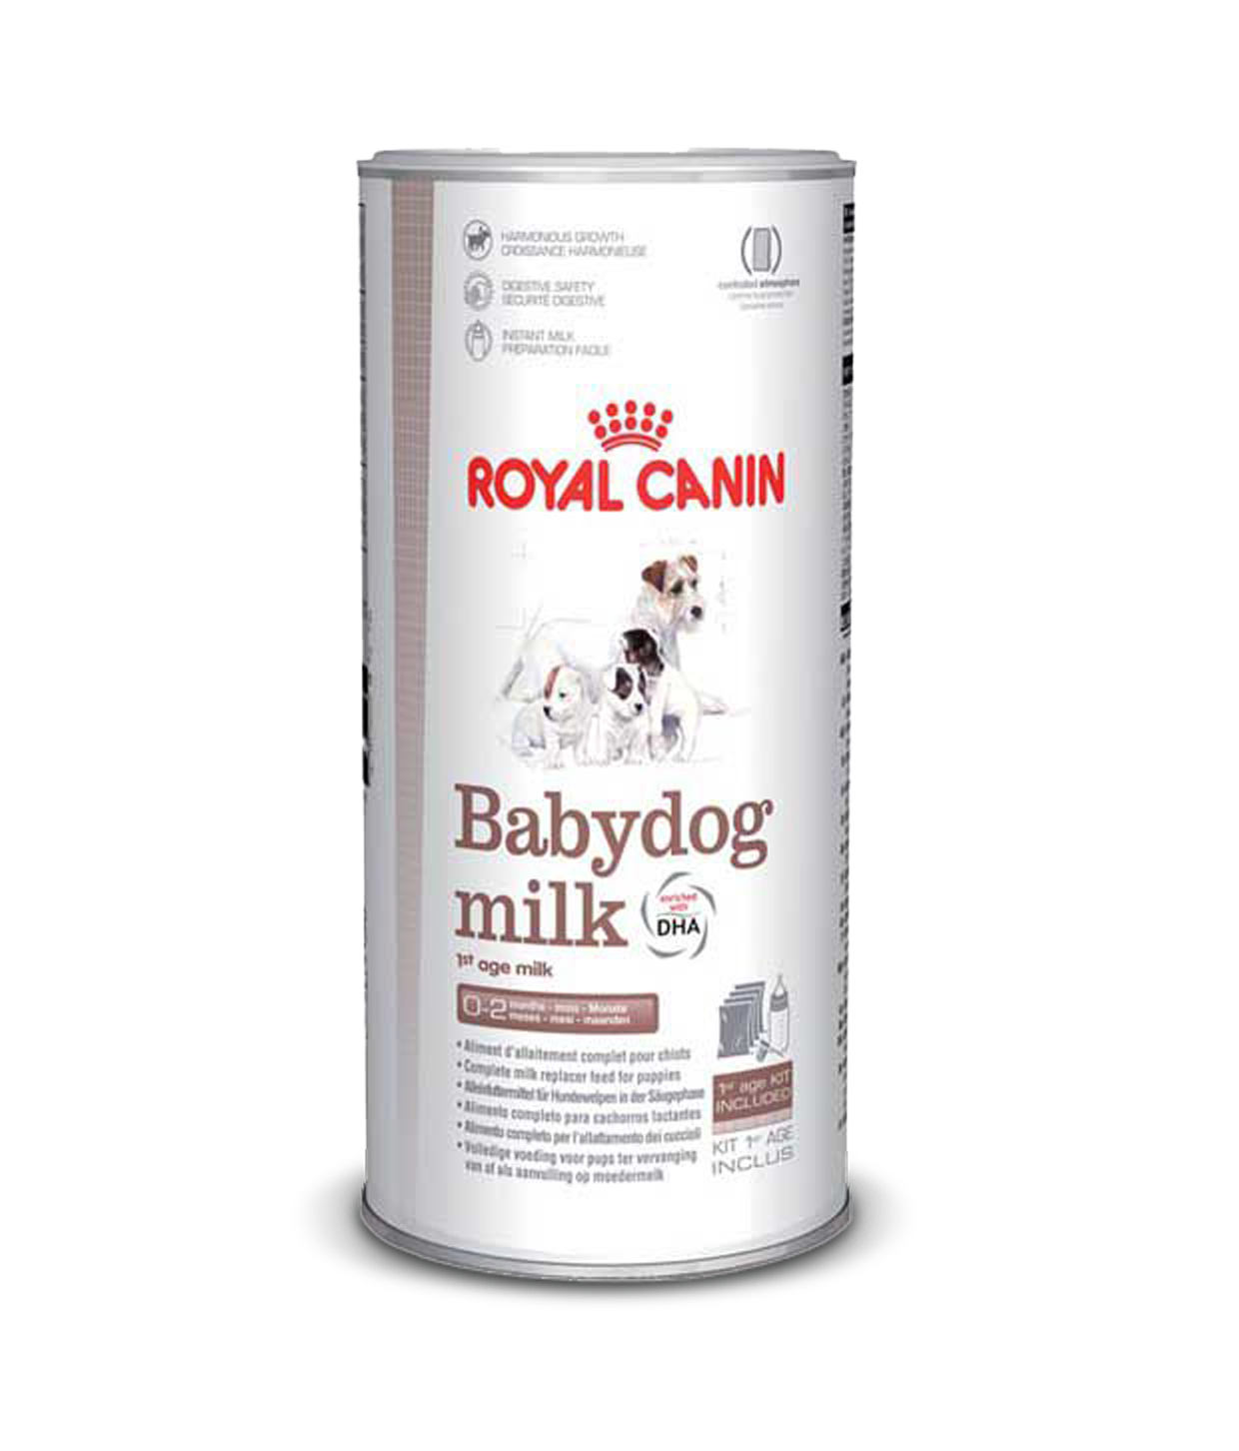
MUST-HAVE #4
MILK REPLACER

Slide 16
PUPPY NEEDS THE RIGHT MILK REPLACER
About the use of Milk replacers
 | CP (Case et al, 2011) | CN (Askins et al, 2001) | CT (Jacobsen et al, 2004)
Energy (kcal ME/L) | 690 | 1400-1800 | 850-1600
PT (%) | 4.6 | 6.9 | 8.7
Fat (%) | 4.5 | 11.4 | 12.7
Lactose (%) | 4.6 | 4.1 | 4.2
Different profiles requiring different nutritional solutions…

Slide 17
OSMOLARITY: HOW TO TAKE ADVANTAGE OF IT

Slide 19
COLOSTRUM
INTAKE
18.1%
WEIGH GAIN !
IG Y
do not receive
enough antibodies
(Mila et al, 2014, 2017)

Slide 20
Antioxidants
Pictures of kibbles in the background
Arrows around the picture with the following text :
Antioxidants
Beta-glucans
Arginine
Digestive safety
Make them appear on click one after the other
Beta-glucans
Digestive safety

Slide 21
NUTRITION AT WEANING
4
WEEKS OF AGE
WEEKS TIME
MEALS PER DAY

Slide 22
Q&A
?
Notes:
The interaction : Which comment you think is the most appropriate ?
Coconut oil
Raw Meat
Human Vitamins
Cottage Cheese
No need to add anything

