Slide 1
Overall Selection Index
Eldin A. Leighton, Ph.D.
Jane Russenberger
1 May 2023
IWDA Breeders Workshop
Vancouver, BC
Canada

Slide 2
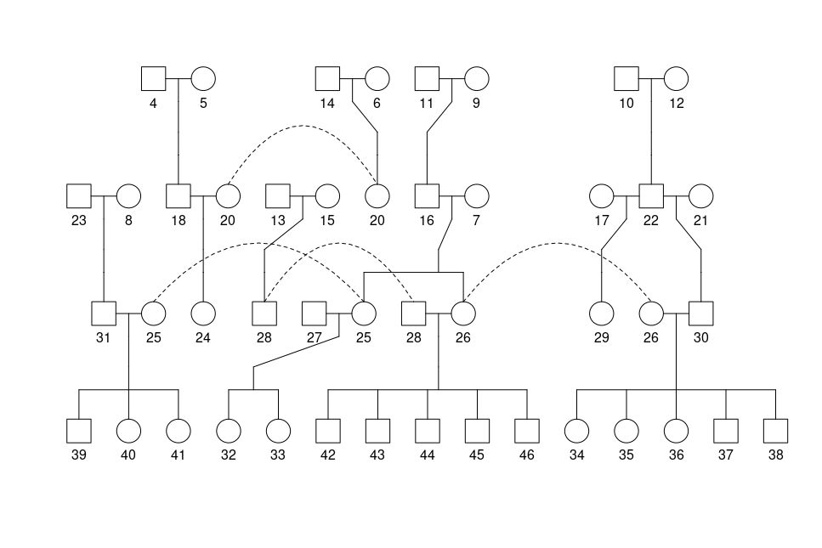
Networks

Slide 3
Networks of Data Sources
Data come from 3 primary sources:
Pedigree relationships
Measurements made on individual dogs AKA: traits or phenotypes
Genomic data, when it is available. SNPs; whole-genome sequence; genetic test panel

Slide 4
Convert data into INFORMATION

Slide 5
Breeding Goals / Breeding Plan
Find out where you are at.
Decide where you want to go.
Follow a plan that will get there.

Slide 6
Most frequent reasons LRs are unable to work
Trait | Weight | Percent with undesirable scores | N with undesirable scores | Total | Heritability
Skin issues | 1 | 16.8% | 970 | 5775 | 0.34
Hip quality | 0.92 | 15.5% | 1146 | 7389 | 0.45
Activated (stress) | 0.62 | 10.5% | 266 | 2537 | 0.17
Inhibited (stress) | 0.61 | 10.3% | 260 | 2527 | 0.10
Body Sensitivity | 0.54 | 9.1% | 229 | 2514 | 0.12
Dog Distraction | 0. 54 | 9.1% | 225 | 2472 | 0.08
Noise Reaction | 0.30 | 5.1% | 128 | 2532 | 0.11
Elbow quality | 0.11 | 1.9% | 130 | 6817 | 0.28

Slide 7
Networks of Data Sources
Data come from 3 primary sources:
Pedigree relationships

Slide 8
Pedigree Relationships

Slide 9
Phenotypic Data

Slide 10
Phenotypic Correlation Matrix

Slide 11
Black Box EBV Calculator

Slide 12
Estimated Breeding Values

Slide 13
Genotypic Correlation Matrix

Slide 14
Most frequent reasons LRs are unable to work
Trait | Relative Economic Values | Percent with undesirable scores | N with undesirable scores | Total | Heritability
Skin issues | 1 | 16.8% | 970 | 5775 | 0.34
Hip quality | 0.92 | 15.5% | 1146 | 7389 | 0.45
Activated (stress) | 0.62 | 10.5% | 266 | 2537 | 0.17
Inhibited (stress) | 0.61 | 10.3% | 260 | 2527 | 0.10
Body Sensitivity | 0.54 | 9.1% | 229 | 2514 | 0.12
Dog Distraction | 0. 54 | 9.1% | 225 | 2472 | 0.08
Noise Reaction | 0.30 | 5.1% | 128 | 2532 | 0.11
Elbow quality | 0.11 | 1.9% | 130 | 6817 | 0.28

Slide 15
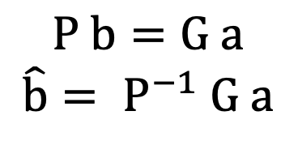
Selection Index Theory
where: P = phenotypic correlation matrix G = genotypic correlation matrix a = vector of relative economic values
b-hat = solution vector of optimal weights
Selection index equations first published in 1943 by Dr. L.N. Hazel https://www.ans.iastate.edu/about/history/people/lanoy-n-hazel

Slide 16
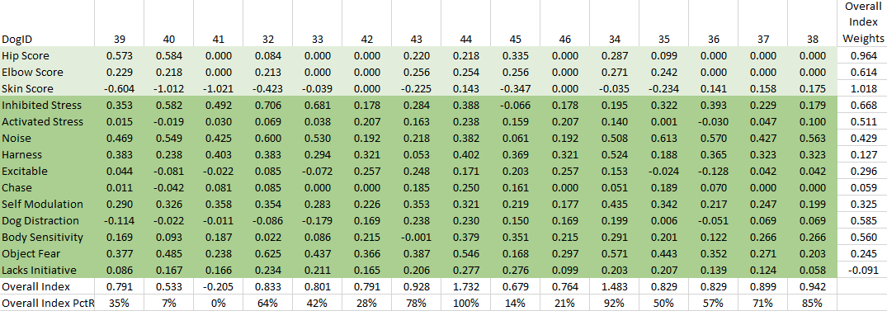
Overall Index Ranking

Slide 17
Thank you!
Questions?

