Slide 1
Analysis of semen traits
Tom Lewis
Guide Dogs UK
Notes:
Going to present some of the main features of an analysis of a number of semen traits, including estimates of heritability.
30 mins

Slide 2
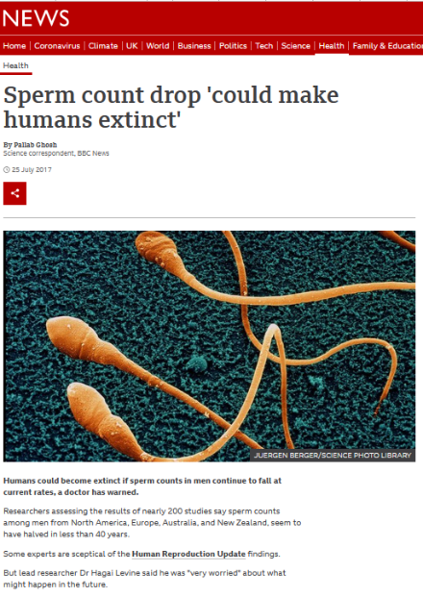
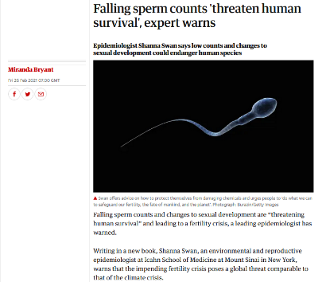
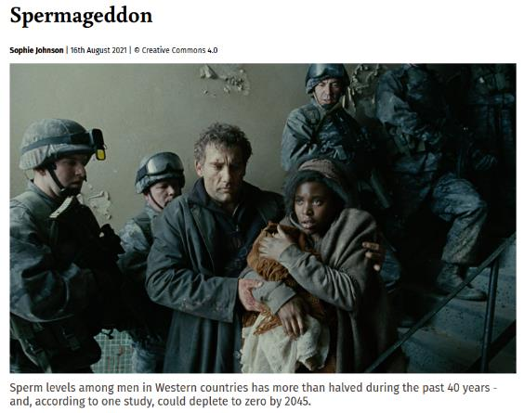
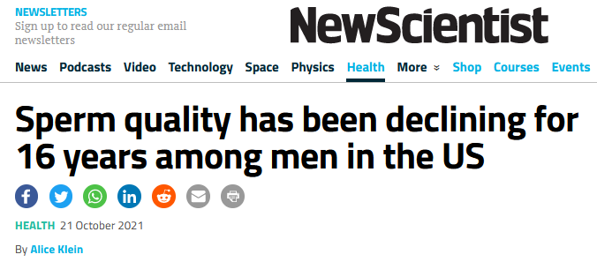
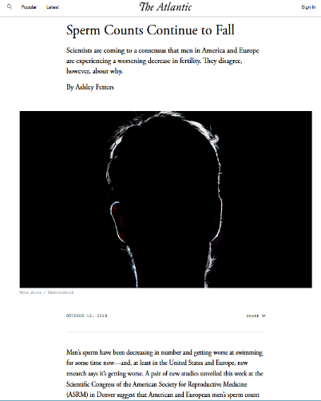
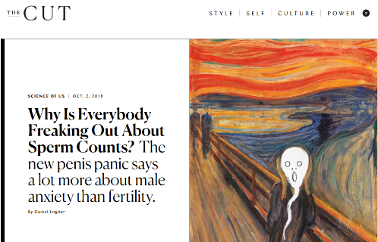
Background – media take on male fertility
Notes:
Background: Generally, there seems to be some concern? The usual calm and measures approach from the media…

Slide 3
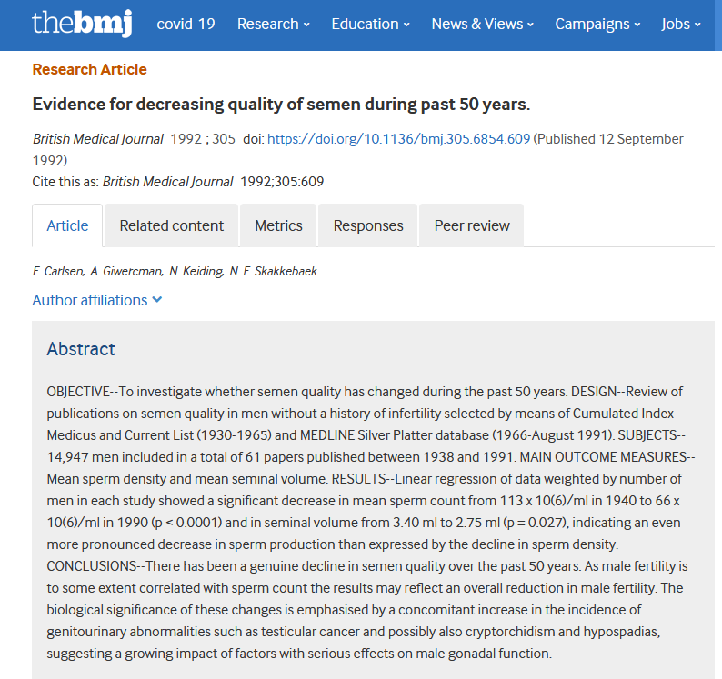
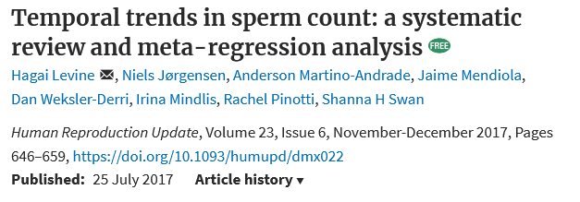
Background – the science behind the story
Notes:
1992 meta analysis reports decline in count (by 42%) and volume (by 19%) 1940-1990
2017 study a meta-analysis, trends adjusted for numerous effects, e.g. age, counting method etc.
NB thick black line = [unselected] western! Does appear to be some grounding, declines in fertile western too.
Although – increasing trend in ‘fertile other’, so hinting at an effect specific to westerners?

Slide 4
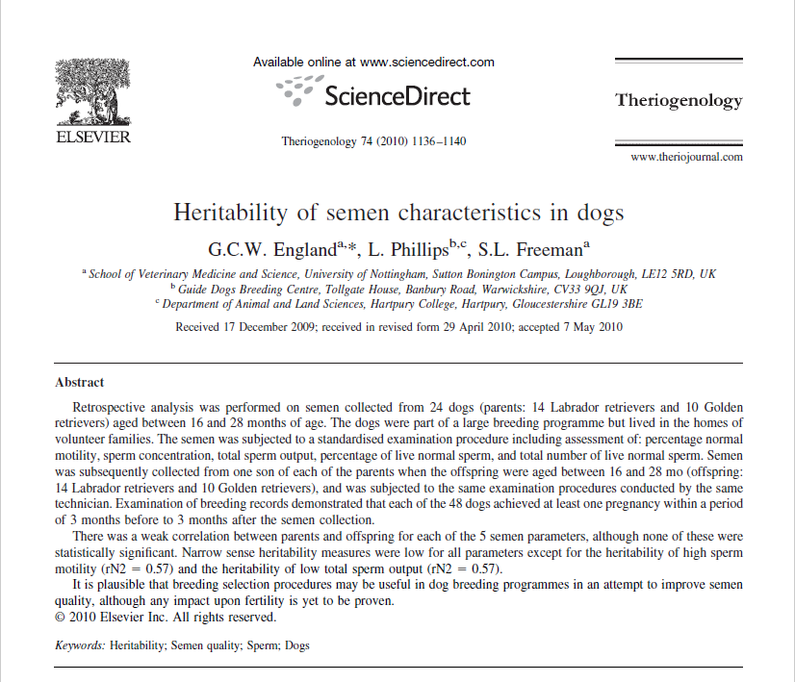
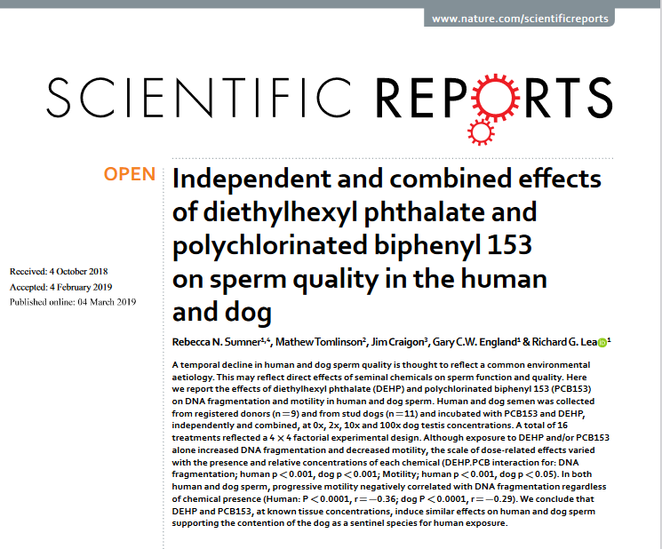
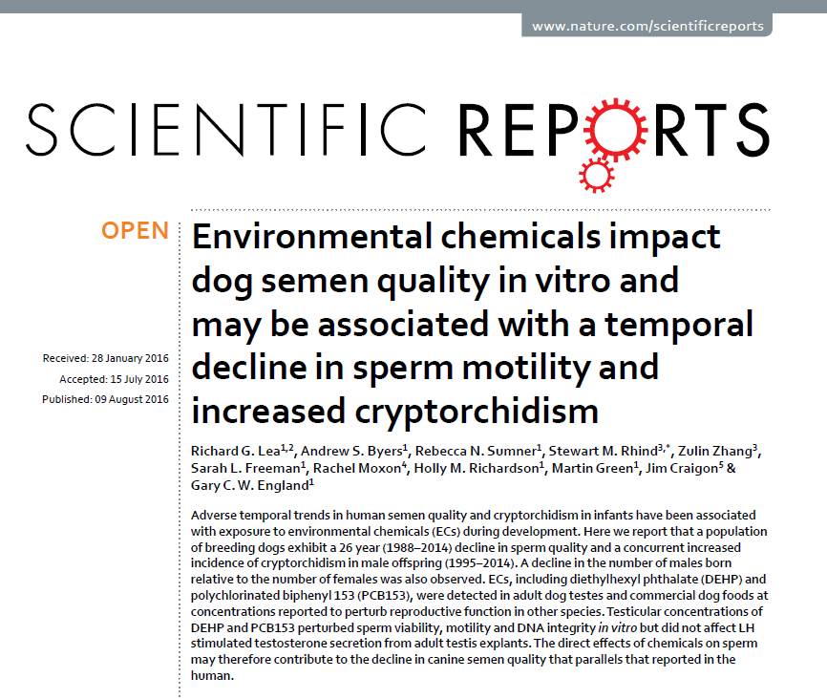
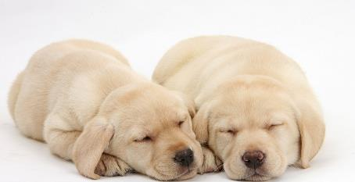
Background – previous work from GDUK
Notes:
But what about dogs?
Gary England paper looking at n=24 dogs, hh = selection response / selection differential (diff from pop mean of progeny / parents). Some categorisation of levels, hh highly variable 0 🡪 0.57.
But overall very little on the heritability of canine semen traits (Morelli et al 2020).
Later work has looked at phenotypic trends and the potential influence of 2 environmental chemicals on DNA fragmentation in the spermatozoa.

Slide 5
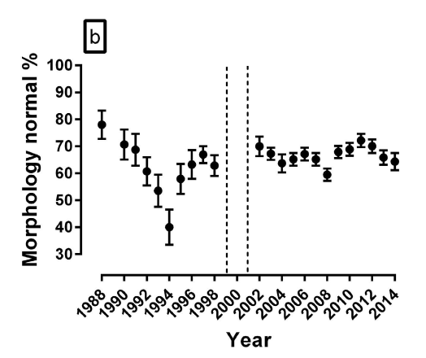
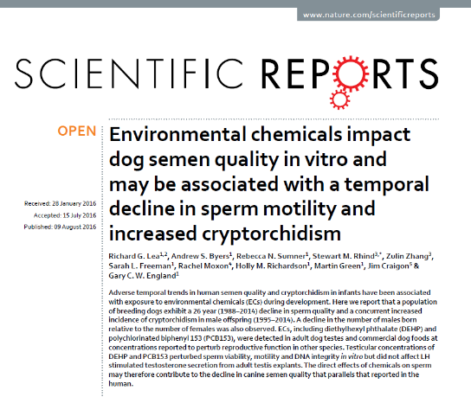
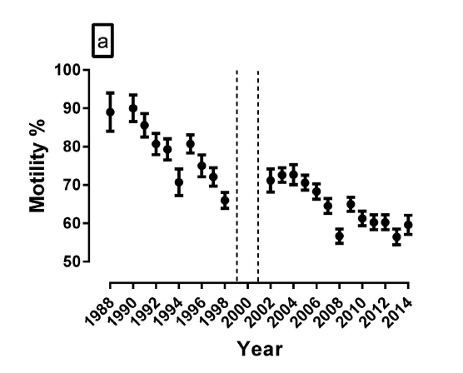
Background - changes in GD populations
Notes:
The first paper showed some temporal changes in GD populations.
The years 1999-2001 are removed as dogs with poor semen quality were removed from the breeding programme in these years.
But certainly a definite downward trend in Motility from 2002-14.

Slide 6
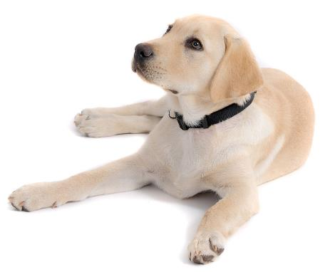
Background - objectives
Determine heritability estimates for a series of semen traits
Determine repeatability (genetics + permanent environment – later!)
Any indication that the traits are related to each other?
Any indication of trends with age / time / inbreeding?
Notes:
Time for an updated look at sperm traits, and to see if we can determine anything about the genetics… Could we offset any changes by selection?

Slide 7
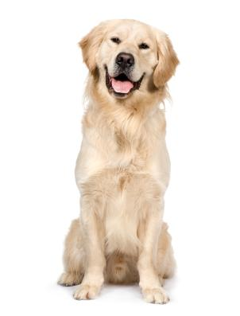
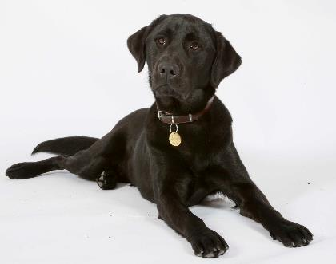
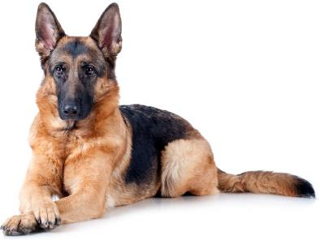
Methods –semen collection
Semen collected from every stud dog for ‘insurance’, fertility checks, export, etc
Collected at various time points over dog’s life
Stud dogs are all ‘purebred’ (use crosses for working or as broods)
Notes:
** most matings are natural!! **
Time for an updated look at sperm traits, and to see if we can determine anything about the genetics… Could we offset any changes by selection?

Slide 8
Methods – data
3 ejaculate fractions collected separately, 5 traits:
VOL - second fraction recorded in ml
MOT - % sperm with fast forward progressive motility
CONC - assessed using haemocytometer counting chamber, millions/ml
TSO = CONC x VOL
TNLS - % total normal live sperm
Notes:
Semen was collected by digital manipulation in the absence of a teaser bitch. The 3 fractions of the ejaculate were collected into separate plastic test tubes via glass funnels. Contamination of the second fraction with the first fraction did not occur using this method. The volume of the second fraction was recorded and then a 25ul drop of undiluted semen was placed onto a warmed glass microscope slide, and motility of the sample was subjectively assessed; the percentages of sperm within each of the following categories were estimated to the nearest 5%: 0 immotile sperm; I poorly motile sperm with no progression; II motile sperm with sluggish progression; III motile sperm with fair but slow progression; IV motile sperm with good progression; and V rapidly motile sperm with good linear progression [7]. The concentration of sperm within the second fraction was determined using an improved Neubauer haemocytometer counting chamber according to the method of the World Health Organisation [8]. The total number of sperm within the ejaculate was calculated by multiplying the second fraction volume with the sperm concentration. The numbers of live and dead spermatozoa and sperm morphology were examined by counting 100 spermatozoa on a nigrosin/eosin stained smear using the classification of Christiansen [9]. Acrosomal integrity was assessed using the classification of Bwanga [10], who found that nigrosin/eosin staining of acrosomes was more discriminative of acrosomal damage than several other methods, although this system was more time consuming. Acrosome status was recorded as either normal or abnormal. Spermatozoa with thickened acrosomes, vesiculated or disintegrating acrosomes, or detached and absent acrosomes were considered abnormal. The percentage of morphologically normal live sperm was recorded, and the total number of morphologically normal and live sperm in the ejaculate was calculated by multiplying the total sperm output and the percentage of morphologically normal live sperm. All data from each dog represented the mean of two semen collections between 3 and 5 days apart with no ejaculations between collections.

Slide 9
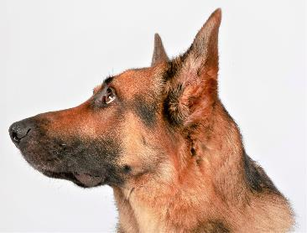
Methods - analysis
Individual breeds analysed separately
Pedigree information used to form ‘relationship matrix’ between all individuals per breed with data
Mixed linear models fitted using ASReml-R
Animal model, include age(m), date and inbreeding coefficient as covariates.
Repeated measures 🡪 permanent environment
Notes:
Induvial breeds – all pure, no cross over.
Pedigree data forms relationship matrix – average genetic relationship of e.g. siblings, half sibs, cousins etc etc.
ASReml R – flexible package
Animal model – direct genetic effects calculated form relationship matrix, including (so accounting for) covariates age(m), date (temporal trend), and COI. Nb LINEAR!!
Repeated measures means we have to try and separate ‘innate’ characteristics, which can be genetic (inherited & shared with relatives) and environmental… See next slide

Slide 10
Methods – repeated measures
Genetics / heritability
- lifelong, inherited, shared
Permanent environment
- lifelong, individual, acquired
Specific environment
- mutable, unique to time
Permanent environment
Specific
Specific
Trait
Genetic
Time, e.g. weekly or monthly 🡪
Notes:
e.g. repeated measures of body weight.
Red – variation in repeat measures. Line = mean. Deviation from line = specific env. (temporal), e.g. feast or fast…!
Blue – similar variation around mean (specific env) but lower mean.
So, what is this difference due to? Genetics + permanent environment (blue could have had a childhood disease that has a long lasting effect on weight)
But if these two are one each of a pair of MZ twins, and we add the other twin for each we can make some deductions. The blue/red pairs have the SAME genetics. So the difference in the red average from blue average is due to genetics. But the difference between the 2 blue and 2 red is NOT due to genetics, and must be due to unique individual permanent environment.

Slide 11
Data description
n=4,016 repeat records, from n = 423 unique dogs
Rec/dog: mean=9.5, sd=6.7, mode=1, median=9, IQR=3.5-14.0, range=1-40
Age(m): mean=54.0, median=51, IQR=30-75, range=11-163
Year: 1990-2022, 75% since 2004, 50% since 2011, 25% since 2016
Inbreeding: mean=6.2%, median 6.3%, IQR=3.7-8.8%, range=0-23.3%
Labs: 2,058 records, 223 dogs
GRs: 1,479 records, 138 dogs
GSDs: 479 records, 62 dogs
Notes:
Records / dog - highly skewed

Slide 12
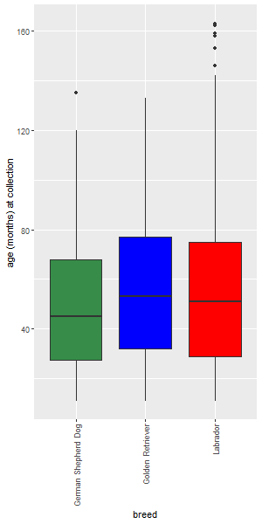
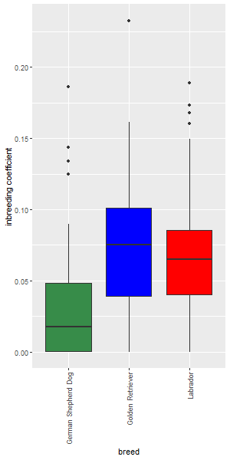
Data description - breed differences
Notes:
Age in months on left, COI on right.
GSD tend to be a bit younger, and less inbred!

Slide 13
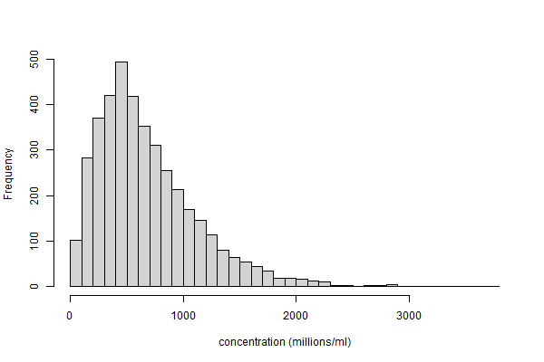
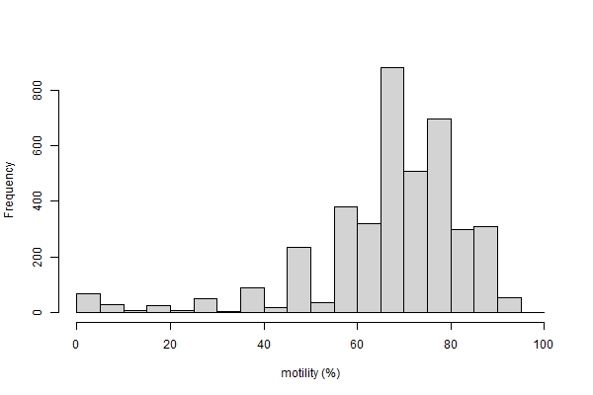
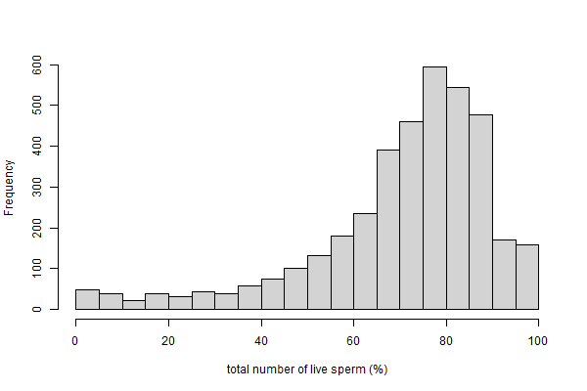
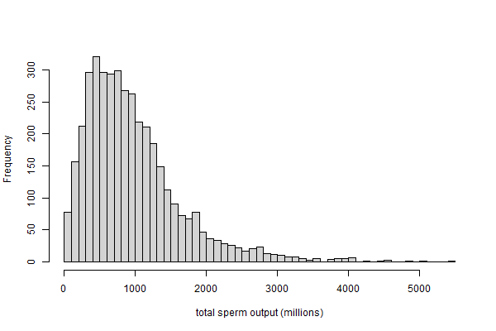
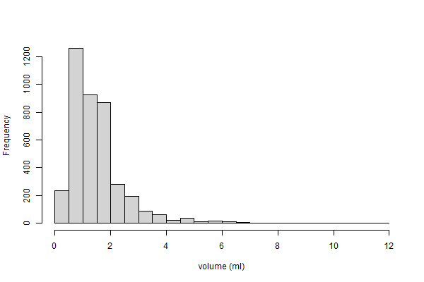
Traits - distributions
CONC
MOT
TNLS
CONCentration – millions / ml
MOTility - percent
Tot. Num. Live Sperm - percent
Tot. Sperm Output – millions (CONC x VOL)
VOLume - ml
TSO
VOL
Notes:
Data pre-pruned for obvious outliers (>100% and vol of 50ml…)
All skewed, tried transformations, no joy.
Conc #FCE4D6
Mot #FFF2CC
Tnls #DDEBF7
Tso #E2EFDA
Vol #F2F2F2

Slide 14
Traits – general correlations
 | CONC | MOT | TNLS | TSO | VOL
CONC |  | 0.096 | 0.035 | 0.687 | -0.288
MOT | *** |  | 0.561 | 0.148 | 0.036
TNLS | * | *** |  | 0.051 | -0.012
TSO | *** | *** | ** |  | 0.310
VOL | *** | * | ns | ***
TSO function of CONC and VOL
TNLS and MOT 🡪 indicator of health?
CONC and VOL 🡪 seminal fluid production?
MOT and TSO 🡪 indicator of health?
Notes:
Traits not independent – TSO is literally conc x vol!
Motility & TNLS – live sperm are motile? Or rather, dead are non-motile!
Concentration & vol – dependent on quantity of seminal fluid
REMEMBER THESE ARE ALL DATA FROM ALL BREEDS – SO ROUGH & READY

Slide 15
Traits – general effects 1 - age
 | regr coef | p-val | adj Rsq |  | yearly | 3-years |  | mean
CONC | -1.494 | *** | 0.0089 |  | -17.92 | -53.77 |  | 683.5
MOT | -0.059 | *** | 0.0098 |  | -0.71 | -2.13 |  | 69.34
TNLS | -0.148 | *** | 0.0454 |  | -1.78 | -5.34 |  | 71.13
TSO | -1.038 | ** | 0.0016 |  | -12.46 | -37.37 |  | 917.3
VOL | 0.0037 | *** | 0.0102 |  | 0.04 | 0.13 |  | 1.613
Notes:
Across all breeds!
Straight regression of each trait on age in months – linear term only (uncorrected for F and temporal). Beware very small Rsq!!
All significant statistically, but not really in magnitude (drop over 3 yrs as % or mean: conc=7.8%, mot=3%, tnls=7.5%, tso=4%, vol=8%)

Slide 16
Traits – general effects 2 - inbreeding
 | regr coef | p-val | adj Rsq |  | +10% | +25% |  | mean
CONC | 202.5 | ns | 0.00007 |  | n/a | n/a |  | 683.5
MOT | -10.33 | ns | 0.00033 |  | n/a | n/a |  | 69.34
TNLS | -38.85 | *** | 0.0057 |  | -3.89 | -9.71 |  | 71.13
TSO | -636.2 | * | 0.0011 |  | -63.62 | -159.05 |  | 917.3
VOL | -2.329 | *** | 0.0078 |  | -0.23 | -0.58 |  | 1.613
Notes:
Straight regression of each trait on F – linear term only (uncorrected for age and temporal). Note very small Rsq!!
BEWARE of stratification within breed.
Only 3 significant statistically, magnitude is somewhat similar although quite large for VOL (drop over 10%F as % of mean: tnls=5.4%, tso=6.9%, vol=14%)
NB: 10%F and 3yrs age not necessarily directly comparable!! Have used as ‘moderate’ increments for illustration.
Conc #FCE4D6
Mot #FFF2CC
Tnls #DDEBF7
Tso #E2EFDA
Vol #F2F2F2

Slide 17
Traits – general effects 3 - temporal
TNLS | regr coef | p-val | adj Rsq |  | yearly | 5-years
ALL | -0.0019 | *** | 0.0754 |  | -0.68 | -3.41
LAB | -0.0018 | *** | 0.0306 |  | -0.65 | -3.25
GR | -0.0023 | *** | 0.1140 |  | -0.84 | -4.18
NB: 2010-19 inclusive, adjusted for age(m) and F (and breed in ALL).
Notes:
TNLS was only trait with consistent temporal trend across breeds – table.
BUT – rsq still small (this is ALL data points and best fit line – so lots of noise).
Better if take average over year, and regress on that (but throwing data/noise away!). Trend is similar however, so OK.
BUT – what about time period? GD problematic here, as ‘selection’ in early part of the century… BUT – trend is not convincing… (These are both for Lab btw)
And this is quite a good illustration – sig declining effect 2010-19 (orange), flat 2007-21 (blue), and ns and small Rsq 1996-2021 (green). This is GR.

Slide 18
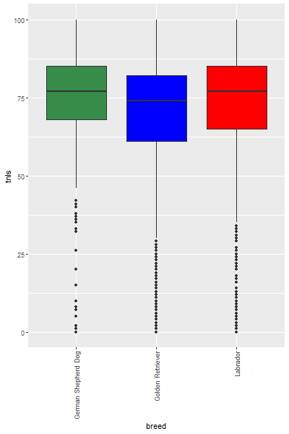
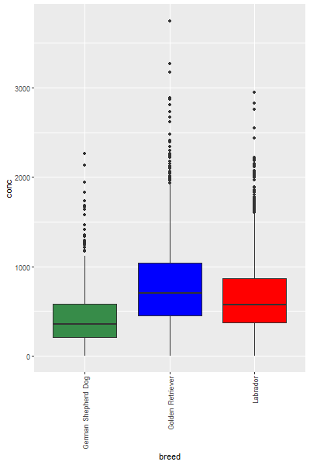
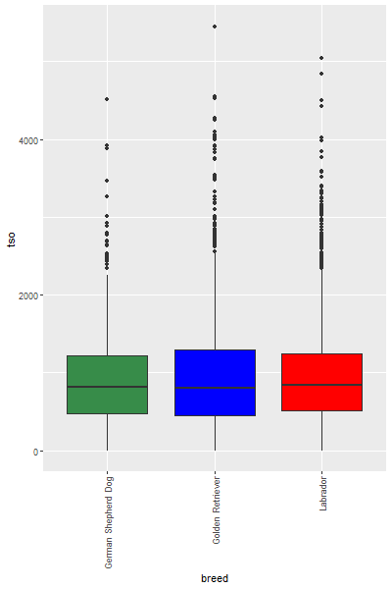
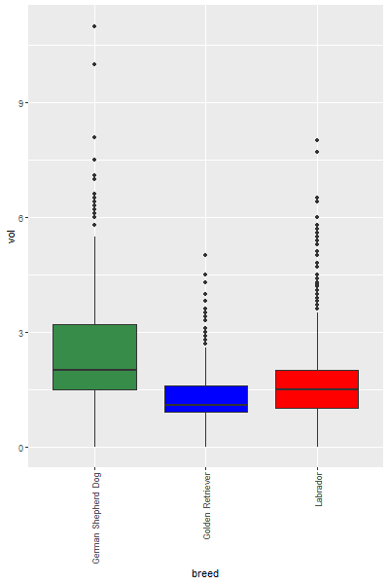
But – trait differences across breeds…
TRAIT | BREED | MIN | Q1 | MEDIAN | MEAN | Q3 | MAX | SD
 | Lab | 0 | 372 | 566.5 | 662.3 | 863.8 | 2950 | 415.9
CONC | GR | 0 | 450 | 700 | 789 | 1040 | 3750 | 478.5
 | GSD | 0 | 210 | 350 | 448.8 | 580 | 2260 | 345.1
 | Lab | 0 | 65 | 75 | 71.21 | 80 | 98 | 15.31
MOT | GR | 0 | 60 | 70 | 66.34 | 80 | 95 | 18.82
 | GSD | 0 | 65 | 70 | 70.57 | 80 | 95 | 15.75
 | Lab | 0 | 65 | 77 | 72.44 | 85 | 100 | 19.52
TNLS | GR | 0 | 61 | 74 | 68.33 | 82 | 100 | 20.50
 | GSD | 0 | 68 | 77 | 74.15 | 85 | 100 | 16.97
 | Lab | 0 | 510 | 840.2 | 966.7 | 1239.8 | 5040 | 653.8
TSO | GR | 0 | 455.5 | 803 | 981.8 | 1291 | 5453 | 734.3
 | GSD | 0 | 472.5 | 817.5 | 958.7 | 1216 | 4520 | 677.1
 | Lab | 0 | 1 | 1.5 | 1.632 | 2 | 8 | 0.933
VOL | GR | 0 | 0.9 | 1.1 | 1.277 | 1.6 | 5 | 0.605
 | GSD | 0 | 1.5 | 2 | 2.567 | 3.2 | 11 | 1.620
Notes:
Conc: GR>Lab>GSD
Mot: pretty similar
TNLS: GR slightly lower?
TSO: all pretty similar
Vol: GSD notably higher, GR narrow and low.
So, there may have been possible confounding in the trends of age(m) etc previously – better to rely on REML estimates

Slide 19
Results – heritabilities & repeatabilities
 | Lab |  |  |  |  |  | GR |  |  |  |  |  | GSD
 | CONC | MOT | TNLS | TSO | VOL |  | CONC | MOT | TNLS | TSO | VOL |  | CONC | MOT | TNLS | TSO | VOL
Vp | 156,479 | 236.07 | 362.5 | 435,685 | 0.8300 |  | 239,039 | 362.42 | 427.6 | 574,930 | 0.3838 |  | 110,792 | 238.21 | 336.7 | 456,008 | 2.8017
se | 7,207 | 10.34 | 19.1 | 19,255 | 0.0388 |  | 12,814 | 30.54 | 34.8 | 31,556 | 0.0217 |  | 9,541 | 21.43 | 40.2 | 38,522 | 0.3277
h² | 0.144 | 0.060 | 0.060 | 0.086 | 0.115 |  | 0.130 | 0.381 | 0.354 | 0.077 | 0.172 |  | 0.00 | 0.00 | 0.454 | 0.00 | 0.457
se | 0.063 | 0.057 | 0.070 | 0.056 | 0.053 |  | 0.068 | 0.111 | 0.108 | 0.073 | 0.072 |  | 0.00 | 0.158 | 0.067 | 0.00 | 0.065
p-val | ** | ns | ns | . | ** |  | * | ** | ** | ns | *** |  | ns | ns | * | ns | **
pe | 0.130 | 0.206 | 0.334 | 0.180 | 0.198 |  | 0.117 | 0.069 | 0.061 | 0.196 | 0.082 |  | 0.279 | 0.268 | 0.00 | 0.264 | 0.00
se | 0.051 | 0.055 | 0.068 | 0.050 | 0.047 |  | 0.055 | 0.081 | 0.078 | 0.065 | 0.053 |  | 0.057 | 0.150 | 0.00 | 0.056 | 0.00
p-val | ** | *** | *** | *** | *** |  | * | ns | ns | *** | . |  | ** | . | ns | *** | ns
rpt | 0.273 | 0.266 | 0.394 | 0.266 | 0.313 |  | 0.247 | 0.450 | 0.415 | 0.273 | 0.254 |  | 0.279 | 0.268 | 0.454 | 0.264 | 0.457
se | 0.031 | 0.030 | 0.032 | 0.030 | 0.031 |  | 0.037 | 0.047 | 0.048 | 0.037 | 0.039 |  | 0.057 | 0.062 | 0.067 | 0.056 | 0.065
Notes:
All traits repeatable (genetic and permanent environment), so some consistency over repeated samples (not totally influenced by specific environment)
Rpt consistent for CONC (0.25-0.28), TNLS (0.39-0.45), TSO (0.26-0.27, outliers for MOT (GR) and VOL (GSD).
Significant heritability estimates in some traits in some breeds… ranging from 11.5% (Lab/VOL) to 45.7% (GSD/VOL). Would be expected to respond to selection.
TSO not heritable in ANY breed, VOL heritable in ALL.
hh estimates are population specific and can vary. However, somewhat surprising that a trait is heritable in one population, and without genetic basis in another.
GSD se=0, implies model issue, probably paucity of data.
Lab/GR MOT/TNLS looks like some difficulty separating the hh from pe.
Shared genetics causes a covariance between relatives, and this is what is determined as additive genetic variance and so heritability. Differences, or confounding in the numbers of records and relationships of dogs in the data may impact the ability of the model to identify genetic or permanent environmental variance. E.g. dog with no relatives but many repeat records. His genetics will clearly play a part but the model will ot be able to ‘identify’ such variation as no relatives.
Tried limiting to samples at 3-5yo to reduce impact of repeated samples, but not much difference (still a lot of repeated samples!)
Also tried using AVERAGES as a trait, but this simply ‘builds in’ permanent environment to individual records…
Nevertheless, we have determined hh for some traits here.

Slide 20
General declining effect of age (m)
 |  | Age (months)
 |  | regr coef | p-val | 12m age
 | CONC | -2.14 | *** | -25.70 | million
 | MOT | -0.069 | *** | -0.83 | %
Lab | TNLS | -0.182 | *** | -2.19 | %
 | TSO | 0.043 | ns | n/a
 | VOL | 0.007 | *** | 0.084 | ml
 | CONC | 0.72 | ns | n/a
 | MOT | -0.081 | *** | -0.98 | %
GR | TNLS | -0.174 | *** | -2.09 | %
 | TSO | 0.358 | ns | n/a
 | VOL | 0.0002 | ns | n/a
 | CONC | -1.33 | ** | -15.80 | million
 | MOT | -0.112 | *** | -1.349 | %
GSD | TNLS | -0.081 | *** | -0.975 | %
 | TSO | -1.731 | ns | n/a
 | VOL | 0.003 | ns | n/a
12m effect
-17.92
-0.71
-1.78
-12.46
0.04
Notes:
ASREML effects of age here, with those from linear regression also given again for comparison.
Not all significant – power effect as have reduced sample size possibly?
BUT – still some significant & similar in magnitude and direction (MOT/TNLS), and similar to effect determined across all breeds.
NOTE – this is still linear!!! And so does not capture any curvi-linearity.
NB:
For inbreeding ONLY effect is in CONC in Lab equivalent to -111.192 million / ml with an increase of COI of 10% – which wasn’t sig across all breeds!

Slide 21
Breed differences in temporal effect
 |  | Effect of time (days)
 |  | regr coef | p-val | 1 year
 | CONC | 0.031 | *** | 11.35 | million
 | MOT | -0.00028 | ns | n/a
Lab | TNLS | -0.00064 | * | -0.23 | %
 | TSO | 0.032 | ** | 11.69 | million
 | VOL | 1.63E-05 | ns | n/a
 | CONC | 0.027 | ** | 9.78 | million
 | MOT | -0.00106 | * | -0.39 | %
GR | TNLS | -0.0016 | ** | -0.59 | %
 | TSO | 0.018 | ns | n/a
 | VOL | 1.80E-05 | ns | n/a
 | CONC | 0.027 | ** | 9.95 | million
 | MOT | 0.00081 | * | 0.30 | %
GSD | TNLS | -0.00033 | ns | n/a
 | TSO | 0.143 | ns | n/a
 | VOL | -7.40E-05 | ns | n/a
Notes:
ASREML effects here… Caution as linear effects again…!!!
All increasing in CONC by ~10 million/ml per year, but otherwise less clear and consistent.
Quality traits seem to show decline in retrievers - TNLS LAB & GR, MOT in GR, but increasing in GSD!
Particularly worrying in GR, and equivalent to declines of 12.7% in MOT and 19.4% in TNLS…
These effects are INDEPENDENT of other effects (so genetic trend) and describe a general decline. Is this evidence of environment differentially affecting breeds (hard to imagine that there would be consistently different environment confounded with breed)?

Slide 22
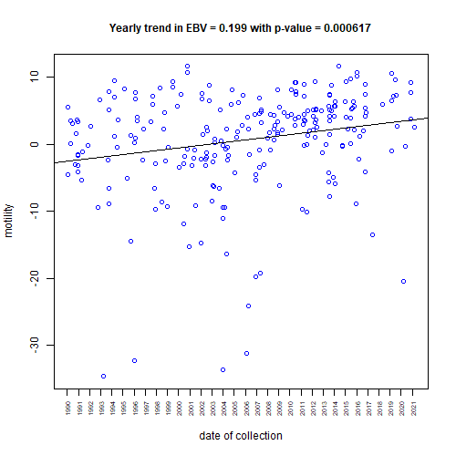
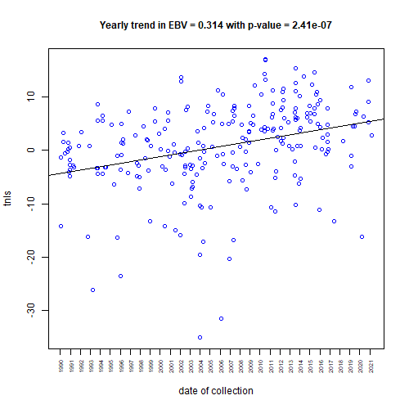
Results – genetic trends
Notes:
So, what is happening to the genetics of GR for MOT and TNLS? We can look at the trend of EBVs to see…
These are EBVs on y-axis, and date of collection (not perfect, could do on dob…), MOT on left and TNLS on right – and there is a positive, increasing, and statistically significant trend, in both. Most likely a response to selection.
(+0.2 vs -3.9% MOT and +0.31 vs -0.59 TNLS).
So, despite genetic selection for INCREASES in these traits, the declines outweigh them…
If we can rule out confounding of environment and breed, then it would appear that this is a breed x environment interaction 🡪 detrimental effects on GR, but not on GSD for example. Interesting…

Slide 23
Caveats & limitations
Breed differences in traits & covariates – should be analysed separately?
Possible differences in n records / relationships affected model
Paucity of data for GSD (only actually 62 dogs!)
Some repeat collections very close together – thin out?
Detected trends are linear – do not capture changes in rates over 30+ years
Notes:
Breed differences in traits (e.g. GSD VOL) and covariates (e.g. GSD YOUNGER) – means should be analysed separately.
There were differences in distribution of nrecords per dog, and kinships, btwn Lab and GR – could this have had an effect on identifying heritability and pe?
GSD data set actually quite small – as was GR (138) and Lab (223) not massive! Think have done quite well in getting hh estimates!
Repeats – removed duplicates, but these came to light later on when looking at nrecs per dog. Some collected on consecutive days – what effect on traits? Should we thin out? But what minimum separation?
Again, the trends are LINEAR – straight line, would like to see if there are varying rates (increasing or decreasing) over the time period.

Slide 24
Conclusions & summary
Semen traits show some degree of repeatability / consistency
Heritability estimates range 0.11-0.46, but variability across breeds and traits
Some difficulty in identifying genetics from perm. env., particularly in MOT and TNLS in Lab & GR
Likely downward effect of age on traits, particularly MOT & TNLS – more work?
Some indication of temporal trends, particularly MOT & TNLS on GR
GR EBVs ‘improving’, so evidence of breed specific env. influence?
Notes:
Nevertheless…

Slide 25
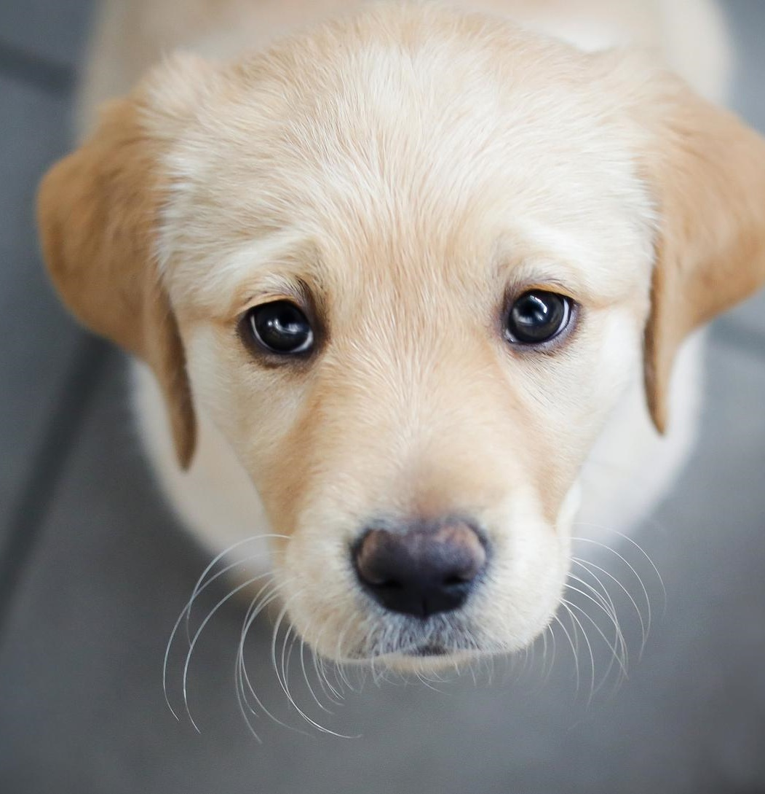
Acknowledgements
Rachel Moxon
Prof Gary England
Thank you.

