Slide 1
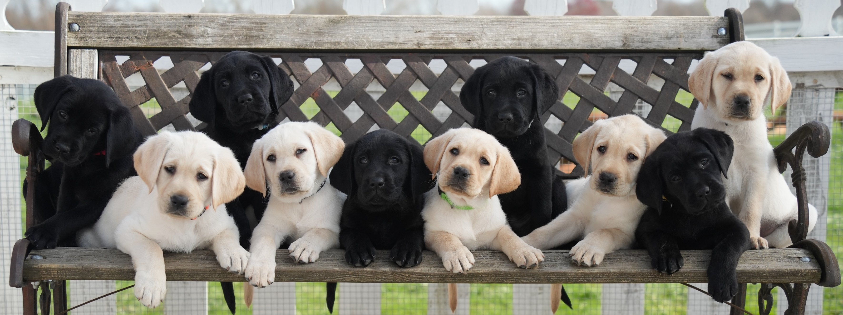
Reproductive Trends & Cryogenic Insights from Guiding Eyes
Clover Williams
Reproduction & Cryogenics Manager

Slide 2
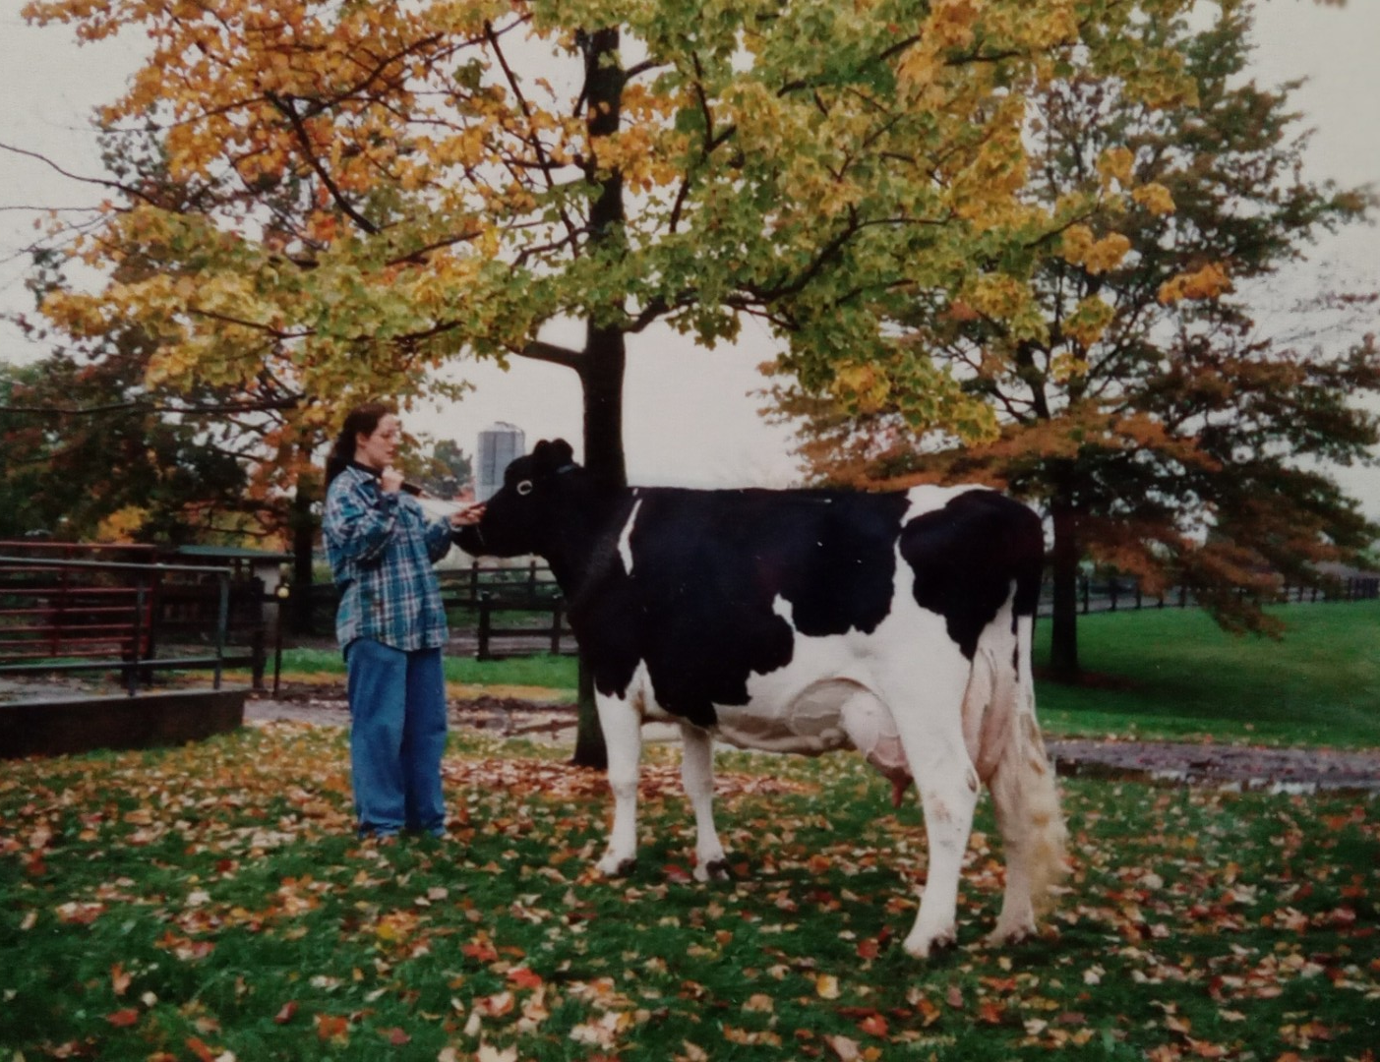
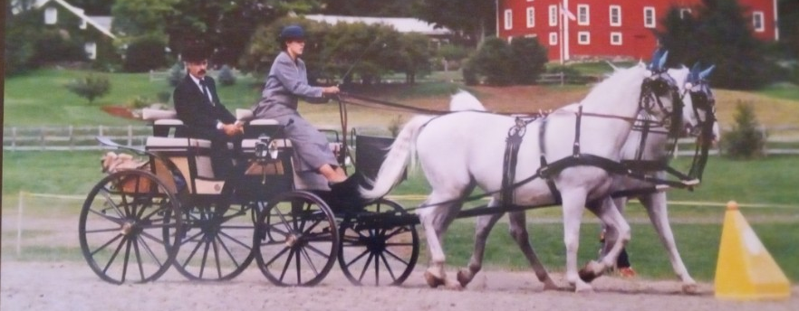
Notes:
Background on dairy farm
.

Slide 3
Notes:
20 years at Guiding Eyes.
Most data sets shown are encompassing 2 decades of data,

Slide 4
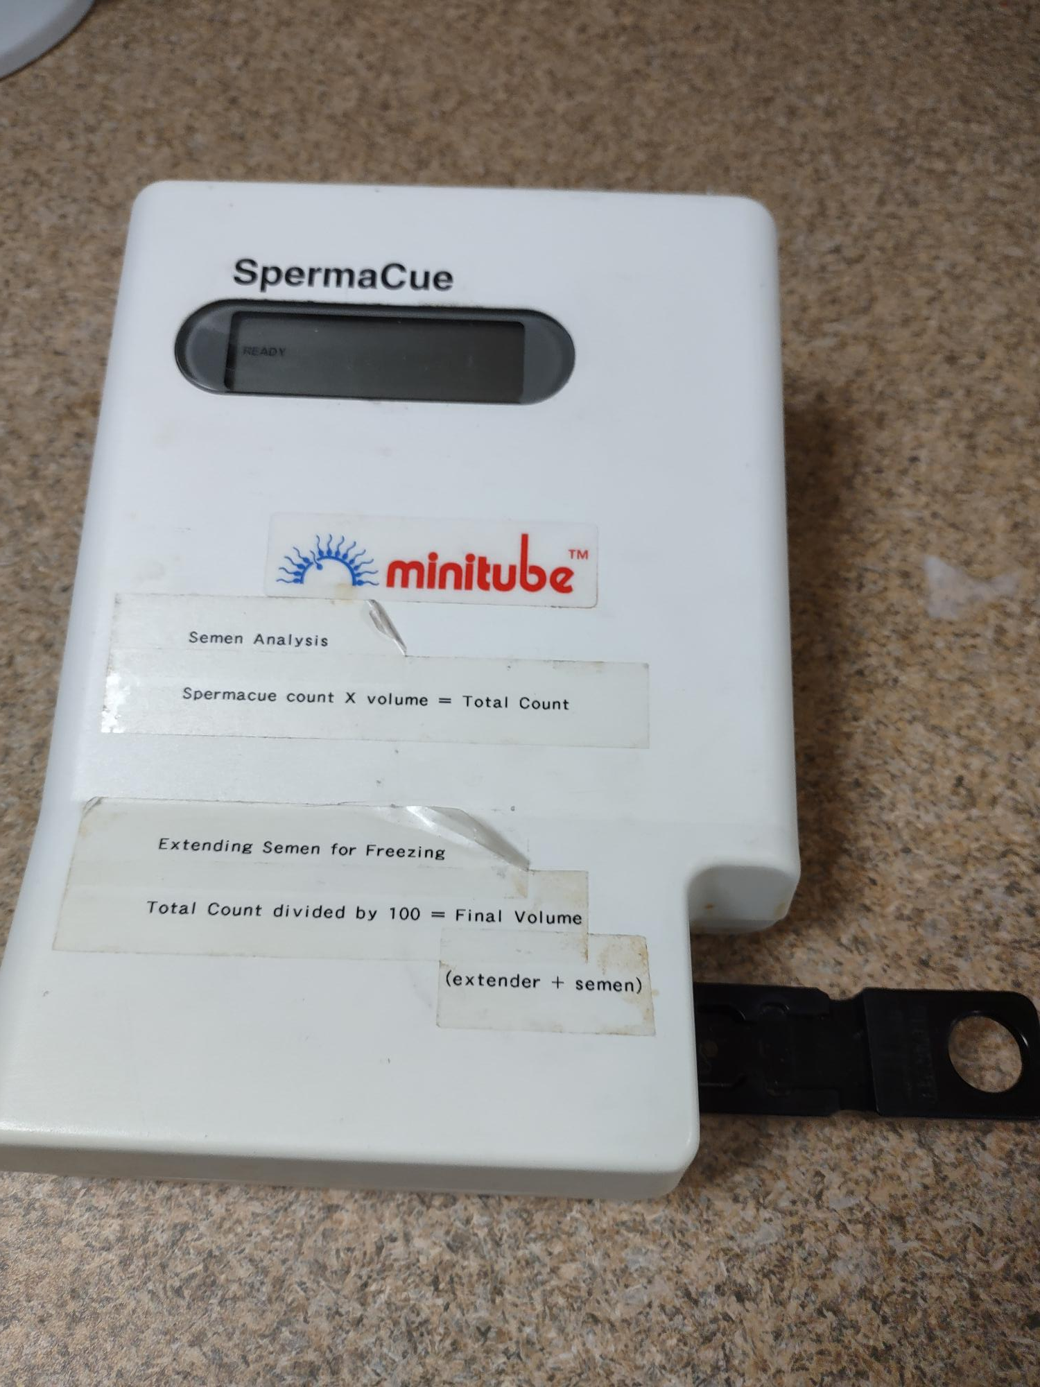
Average Total Semen Count (10⁶) at 2 Years of Age
Notes:
This chart looks at average total semen counts on dogs that had multiple analyses, rather than highest or lowest. Please disregard the seemingly high counts on the front end as data was not comprehensively stored in the database until 2002. The contemporary group is not typical data due to reduced/delayed screenings of males through the COVID shutdowns. not the highest or lowest count or the first ejaculate. on the aveage of all semen counts by dog where the average of any that were done at age 2 years for that dog was used (rather than the 1st or last or highest or lowest etc)- Answer- it is dropping
7/9/2004 Spermacue 1/2018 Casa installed

Slide 5
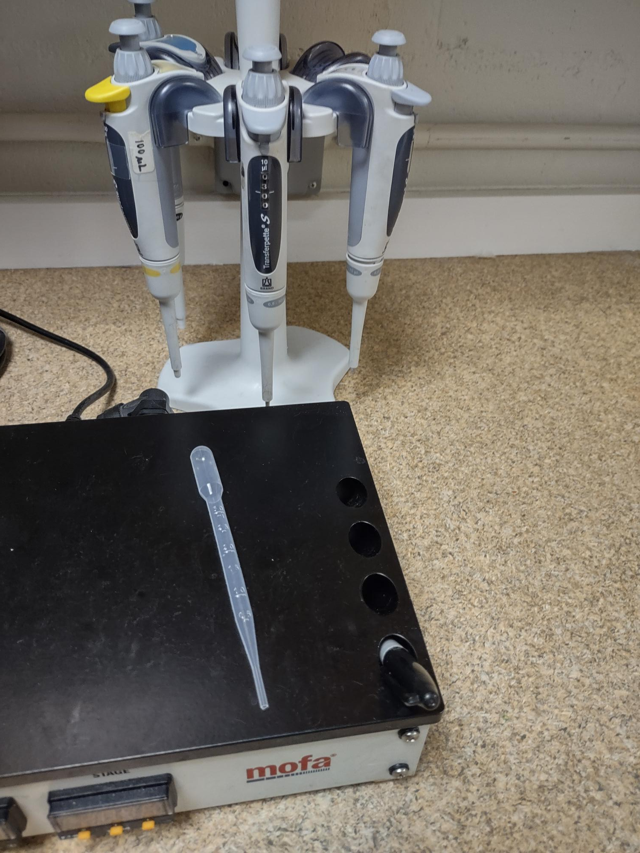
Average % Motility at 2 years of Age by Year Born
Notes:
Up until 2018, motility was completely subjective at Guiding Eyes. Drop size of semen matters

Slide 6
Average % Abnormal Semen By Age (Yrs) Evaluated
Notes:
intuitive. The older the stud gets the more morphological defects are seen.
Breed young, freeze young.
We bank semen during the breeder screening process, often complete before his first natural mating.

Slide 7
Semen Parameters
My yellow “take notice” flags on young studs
<70% motility
>20% abnormal sperm
<250 10x6 sperm in the ejaculate
Good hot, teaser bitch?
Was he stressed?
Medical history
Was his sire problematic?
Notes:
Stud comfort. Stress…

Slide 8
Azoospermia
After 2-3 collections with good libido/low stress, good teaser bitch
Seminal fluid ALK/PHOS value
>5000 U/L – confirms azoospermia
<5000 U/L – points to incomplete ejaculation, reassess collection/teasing techniques
Notes:
2-3 collections over time, teaser bitches,, then ALK/PHOS levels. Make sure lab knows that you are submitting seminal plasma

Slide 9
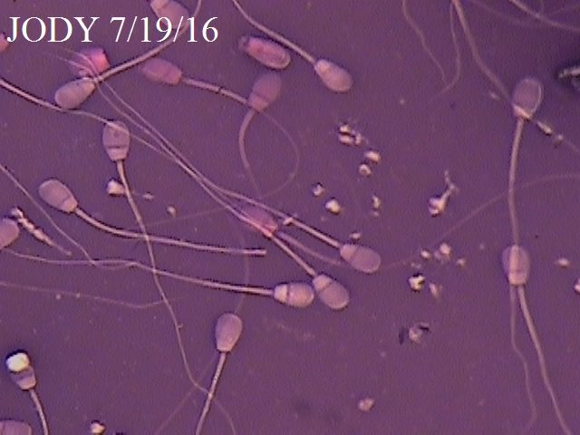
Semen Quality can change fast…
Notes:
Jody- didn’t track him out. Had banked semen Perry- Cefpodoxime, newest class of Cephalosporins

Slide 10
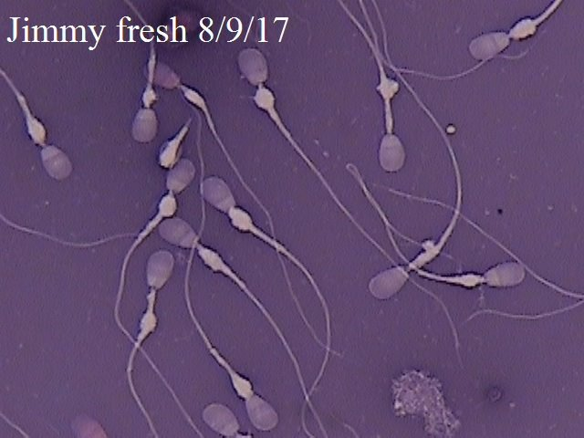
Psuedo-droplets/ Jumbled Mitochondria
Notes:
randomly jumbled mitochondria suggestive of testicular deg. Early age => cull

Slide 11
Pleomorphic semen
Notes:
Testicular degeneration at a young age. With the absence of any recent fever or illness => cull

Slide 12
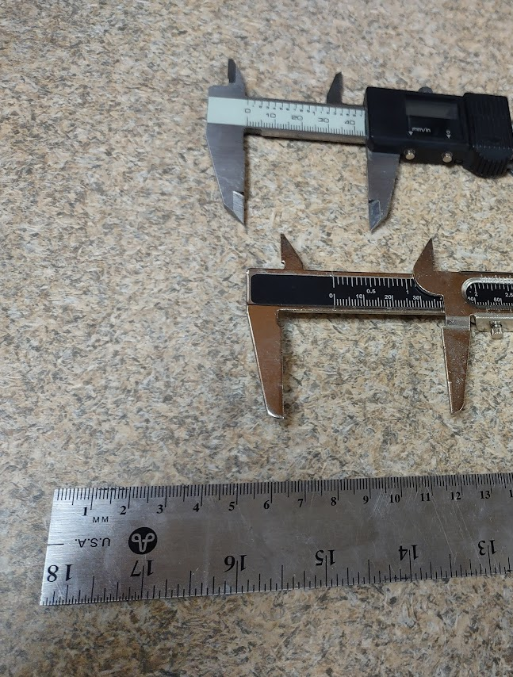
Scrotal & Penis Measurements
Testes 60 – 70mm across
Bulbus Glandi <55mm can be problematic
Buzz 50mm 68#/ 30.8kg
Notes:
Baseline readings at Breed Eval. Just for reference

Slide 13
Average Litter Size By Age of Sire At Mating

Slide 14
Average Litter Size by Year Born
Notes:
7.7 conceived down to 7.3 over 20 years

Slide 15
Inbreeding Coefficient by Year Born
Notes:
7% to 12% over last 20 years

Slide 16
Average Inbreeding Coefficient by Year Born
5 Year Range
Notes:
Same data in 5 year groupings show the effects of collaborative breeding exchanges both domestically within the US and internationally.

Slide 17
Interestrous interval

Slide 18
Heat Interval Range: Active Broods Born Before 2020

Slide 19
Average Litter Size by Heat Interval Range Active Broods Before 2020

Slide 20
Should we breed on consecutive heats?
Notes:
Short answer yes! Breeding young, healthy broods consecutively shows the highest litter size average for GEB.
A healthy uterus is a pregnant uterus. There is not significant difference with skipping an occasional heat, but a definite difference is seen when you infrequently breed. We’ll have to do some further digging to see why we skipped the low group so much but I would bet they were

Slide 21
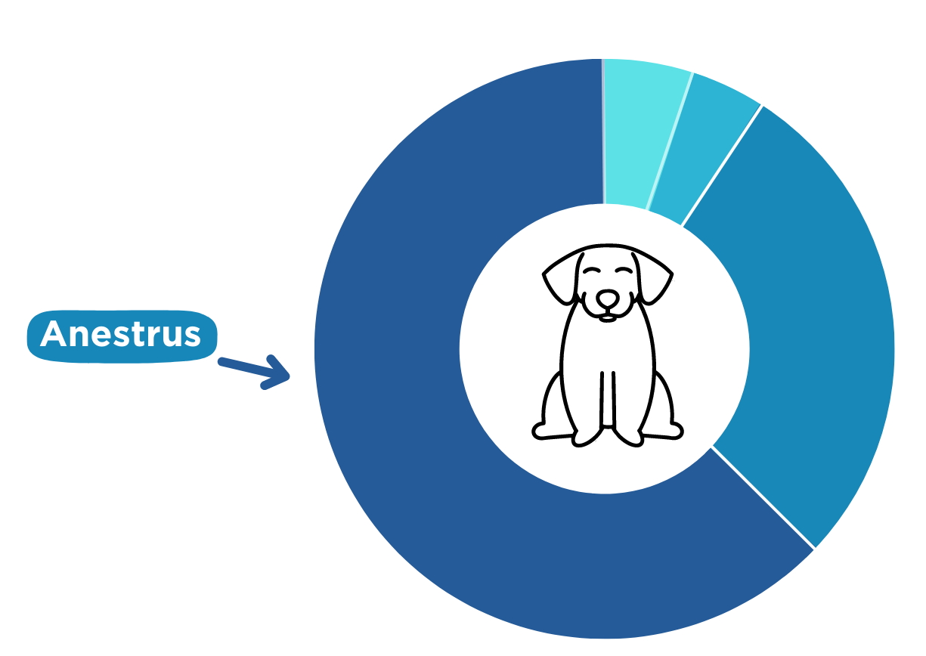
Jumpstarting a Heat

Slide 22
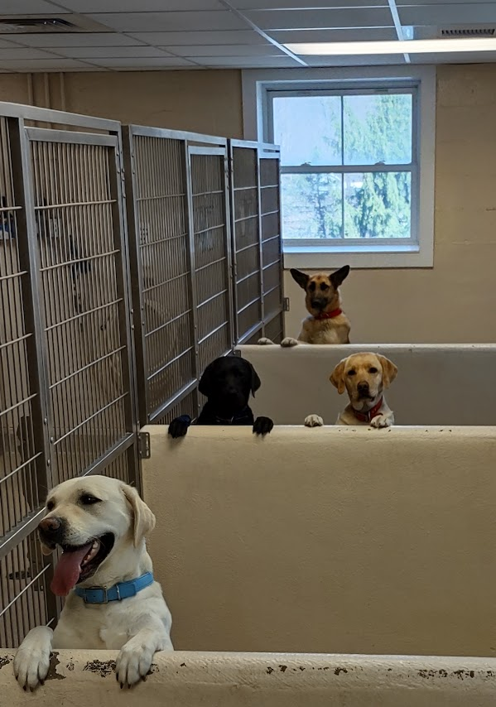
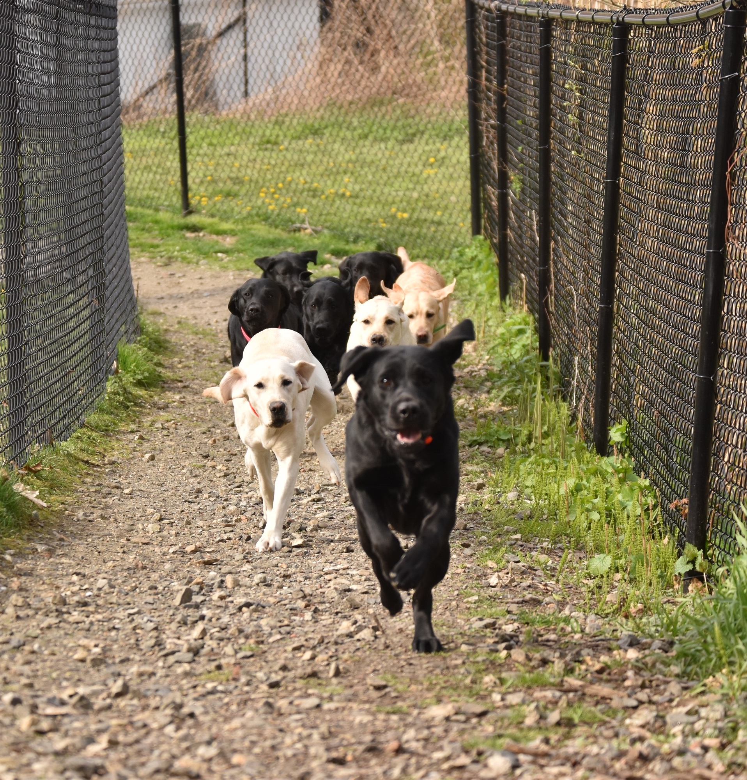
Jumpstarting Heat – How?

Slide 23
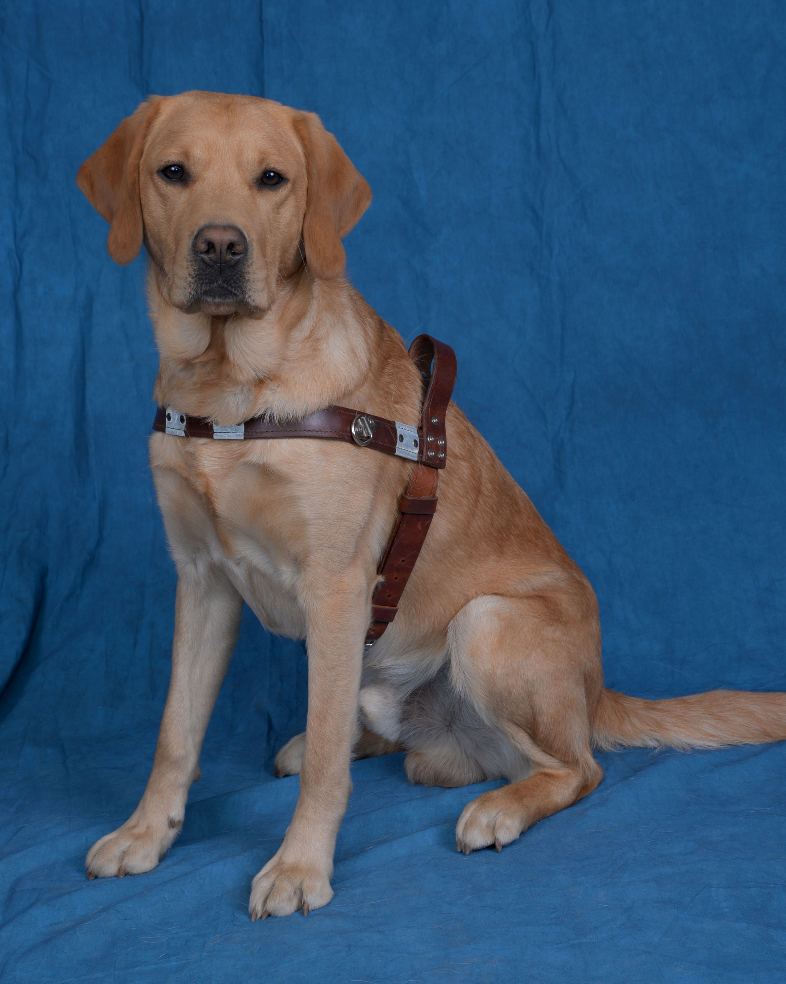
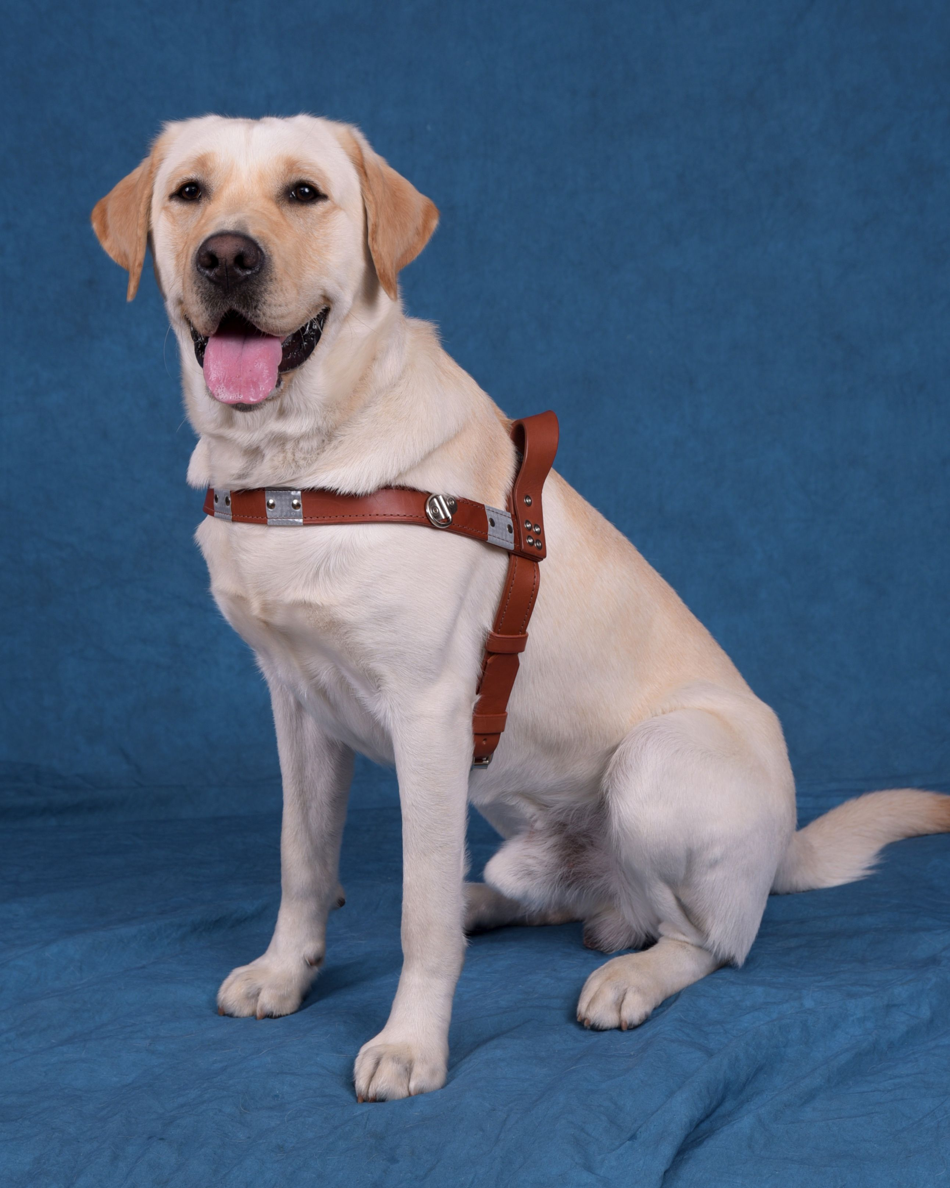
Improved Frozen Semen Success with the Addition of a Mating with a Vasectomized stud
The Dud Studs of Guiding Eyes

Slide 24
Frozen Semen Conception Rate Comparison Vasectomized Male vs Without

Slide 25
Frozen Semen Average Litter Size Comparison With Vasectomize Male vs Without

Slide 26
Average Litter Size by Semen Type 1996 - 2023

Slide 27
Frozen Semen Litter Size Groupings Comparing the Use of Vasectomized Male

Slide 28
Key Factors for Our Success with Frozen Semen
Freeze semen on young males
Consistent Qualitative Progesterone testing for timing
+/- LH Testing
Competence with thawing and insemination technique – Speed
7 days a week commitment
Access to semen - No FedEx or UPS transport delays
Consistency – thaw recommendations, follow them!!!!

Slide 29
Why should an organization freeze semen
Insurance policy against Loss of Use of the stud dog
Dual Career
Sharing with others
Notes:
If you are following the Principles of Genetics, old semen loses value quick. Annual assessment of who you are storing

Slide 30
Should your organization pursue frozen semen
Build and Maintain a Cryobank
Completely outsource to university or reproductive specialty practice
3) Receive and store semen from other orgs

Slide 31
Building and Maintaining a Cryobank
Pros:
Everything is on site
Price per dog is reduced
Freeze many
Cons:
High Start up costs
Phase Contrast microscope & Semen counter (iSperm,SDMI1/SpermaCue) $15,000
CASA $35,000 - $60,000
Liquid Nitrogen
Dedicated space
Staffing Training and turnover- bench strength is key
Record keeping and maintenance of tanks
Access to teaser bitches - Prostaglandin F2α (PGF2α)
Notes:
Be careful of disgruntled employees.

Slide 32
Outsourcing to University or Repro Practice
Pros:
No Start Up Costs
No concern about your organization’s skill set or staff turnover
Cons: Cost/dog is much higher plus annual storage fees (~$700-$1000USD/ dog/freeze)
Weekend inseminations can be a problem
Requires transport and scheduling logistics
Timing with P4
Notes:
Some orgs have purchased equipment for private practice with contracts for free services.

Slide 33
Receive Frozen Semen and Inseminate In-house
Pros:
Great genetic diversity
Semen is always available
Cons:
Surgical or TCI training and competency required
Access to quality P4 testing
Thawing semen skills
Maintenance of your storage tank
Sourcing the semen
Notes:
Some orgs have purchased equipment for private practice with contracts for free services

Slide 34
Resources for Cryo & Reproduction Equipment
Minitube www.minitube.com
Phase Microscope $3000 - $10,000
CASA (computer assisted semen analyzer) $30,000- $65,000
SDM1 Spermacue $2800
SC 4/3V Vapor shipping container $1500 +$500 case
SC 20/20 storage $1375
Cryo freeze box $1200
TCI scopes $10,000-25,000 depending on system
TCI Training Course $2500/person instruction am/wet lab pm
Straw Labeling machine $22,000
Straws, Marker rods, cryo pens, misc supplies

Slide 35
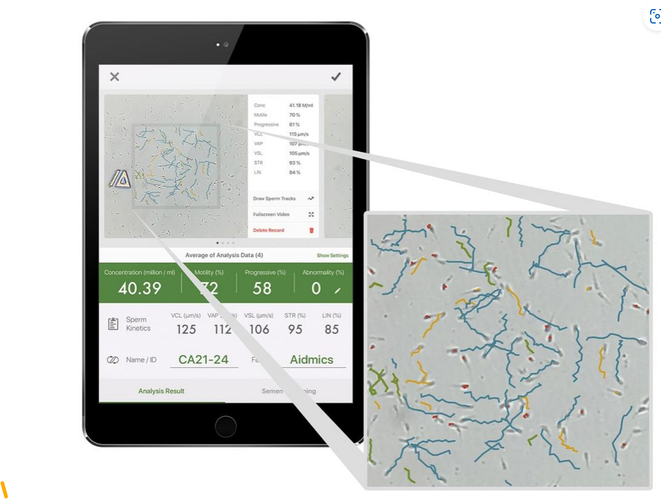
IMV www.imv-technologies.com
Semen Assessment
Cryo Tanks
Misc Cryo supplies
iSperm www.breederschoiceonline.com
motility and concentration $2350 USD

Slide 36
Tosoh- Progesterone analyzer -- Tosoh 360 $30,000 https://www.tosoh.com/

Slide 38
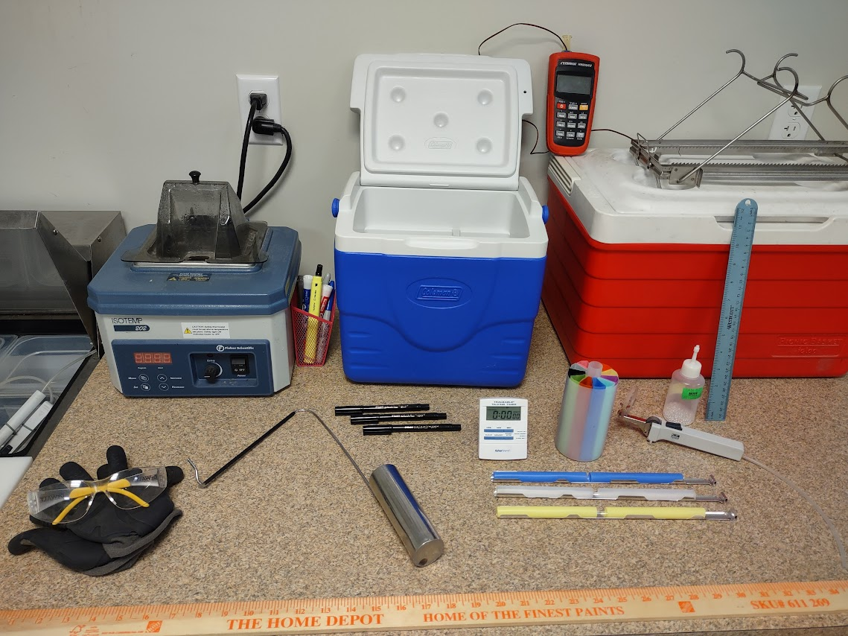

Slide 39
cwilliams@guidingeyes.org

